Slide 1
The power of orchestration
for smarter & faster compliance

Slide 2

The compliance pressure cooker
Notes:
Visual: A messy desk with sticky notes everywhere, a spreadsheet open, alerts on screen, and a frustrated compliance officer.
Let’s talk about stress.
Not the "we ran out of coffee" kind.
I mean the kind where your onboarding is stuck, your AML checks are manual, and your customer files live in five different systems and your AML process depends on
someone remembering to check a list every Tuesday — all while a regulator might knock any day.
Sounds familiar? That’s the world many financial institutions live in today.
And I haven’t talked yet about scaling across borders or counterparties. That only multiplies the chaos.

Slide 3
The Compliance pressure cooker
✅ Seamless KYC/KYC onboarding across departments
✅ Real-time AML checks and monitoring
✅ Fully auditable processes
✅ Scalable remediation capability
✅ Consistent data and controls across teams
✅ Proactive compliance with AMLD6, AMLA, FATF
✅ Cost-efficient operations with fewer resources
🚩 Slow & fragmented onboarding
🚩 Manual checks across multiple tools
🚩 Remediation backlogs consuming months
🚩 Client data scattered across disconnected systems
🚩 Risk scoring and approvals via spreadsheets
🚩 Reactive compliance under audit pressure
🚩 Resource strain and compliance fatigue

Slide 4

Clients
Vendors
Funds
UBO’s
Brokers
Transactions
ID’s
Who are my COUNTERPARTIES, really ?
KYC / KYB / KYS / KYE / KYX
Notes:
And here’s the thing.
Compliance isn’t just about knowing your customer anymore.
It’s about knowing your counterparty. Whoever that may be.
And they’re not just customers. They’re UBOs, subsidiaries, fund managers, brokers, suppliers, even employees. Each with their own documents. Risk profiles. Checks.
And guess what? That risk never stands still.

Slide 5
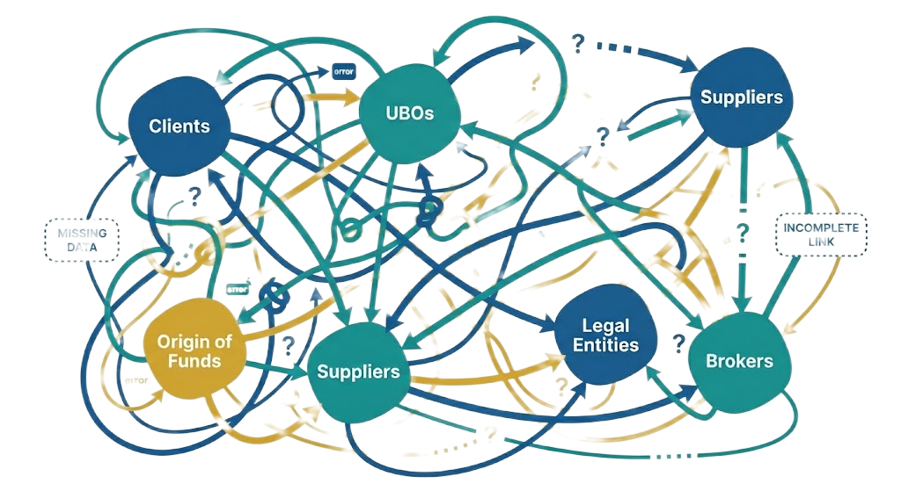
Compliance at scale is broken
Structures are more complex than ever
Data is inconsistent or missing
Every jurisdiction adds new obligations
And then
Remediation is coming…
Without orchestration, it’s mission impossible

Slide 6

What if compliance doesn’t have to be like this?
Notes:
What if compliance wasn’t chaos?

Slide 7


Orchestrator of compliance workflows for counterparty lifecycle
Notes:
What if you could orchestrate it, across teams, tools & countries, without losing your mind?

Slide 8

A customisable & modular platform that grows with you
UBO verification & confirmation
Document validation & fraud detection
Automated data & document enrichment
Digital signing
Identification & validation
AML, PEP & adverse media screening
Comprehensive risk scoring engine
Reporting & analytics
Case management & continuous risk monitoring
Client outreach
Transaction monitoring
MiFID, IDD, ESG & DORA profiling
Notes:
We built a modular, fully configurable platform that automates and orchestrates compliance workflows across the entire counterparty lifecycle.
From onboarding to offboarding. From screening to risk scoring.
From messy to manageable.

Slide 9

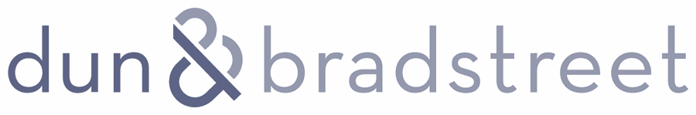

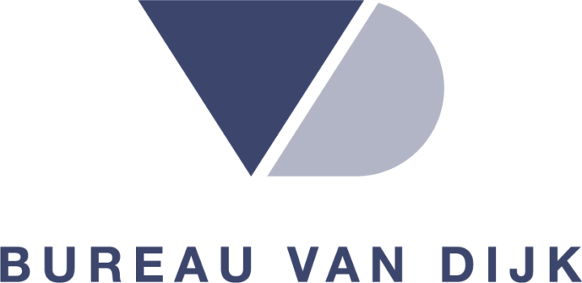





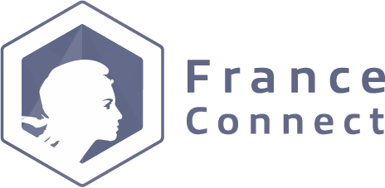







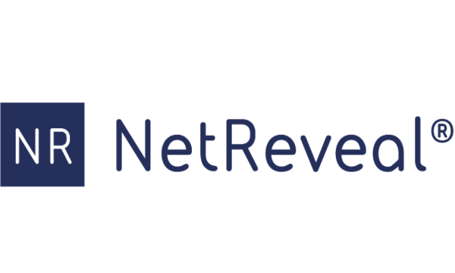




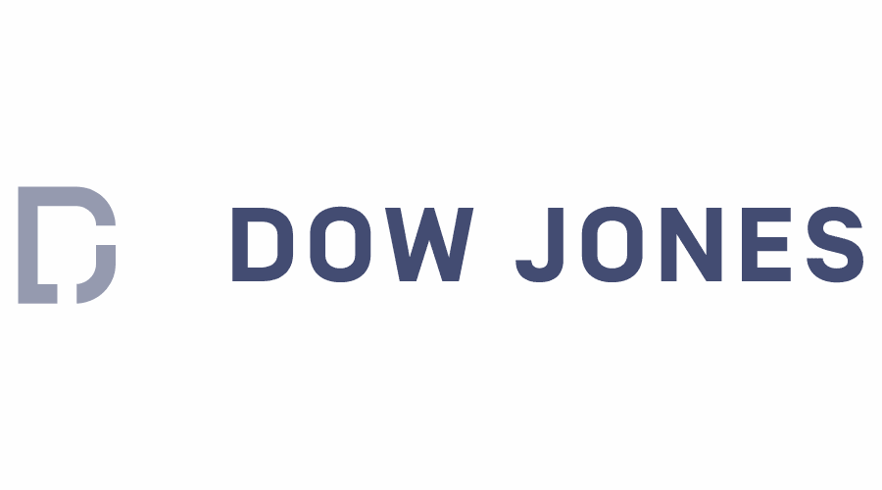


We orchestrate the ecosystem with seamless API integration
KYC Data
Transaction Monitoring
Core Systems
CRM Systems
Digital Signing
AML Screening
ID & V
Notes:
We orchestrate an open ecosystem with seamless API integration that allows us to add any point solution to Harmoney.

Slide 10
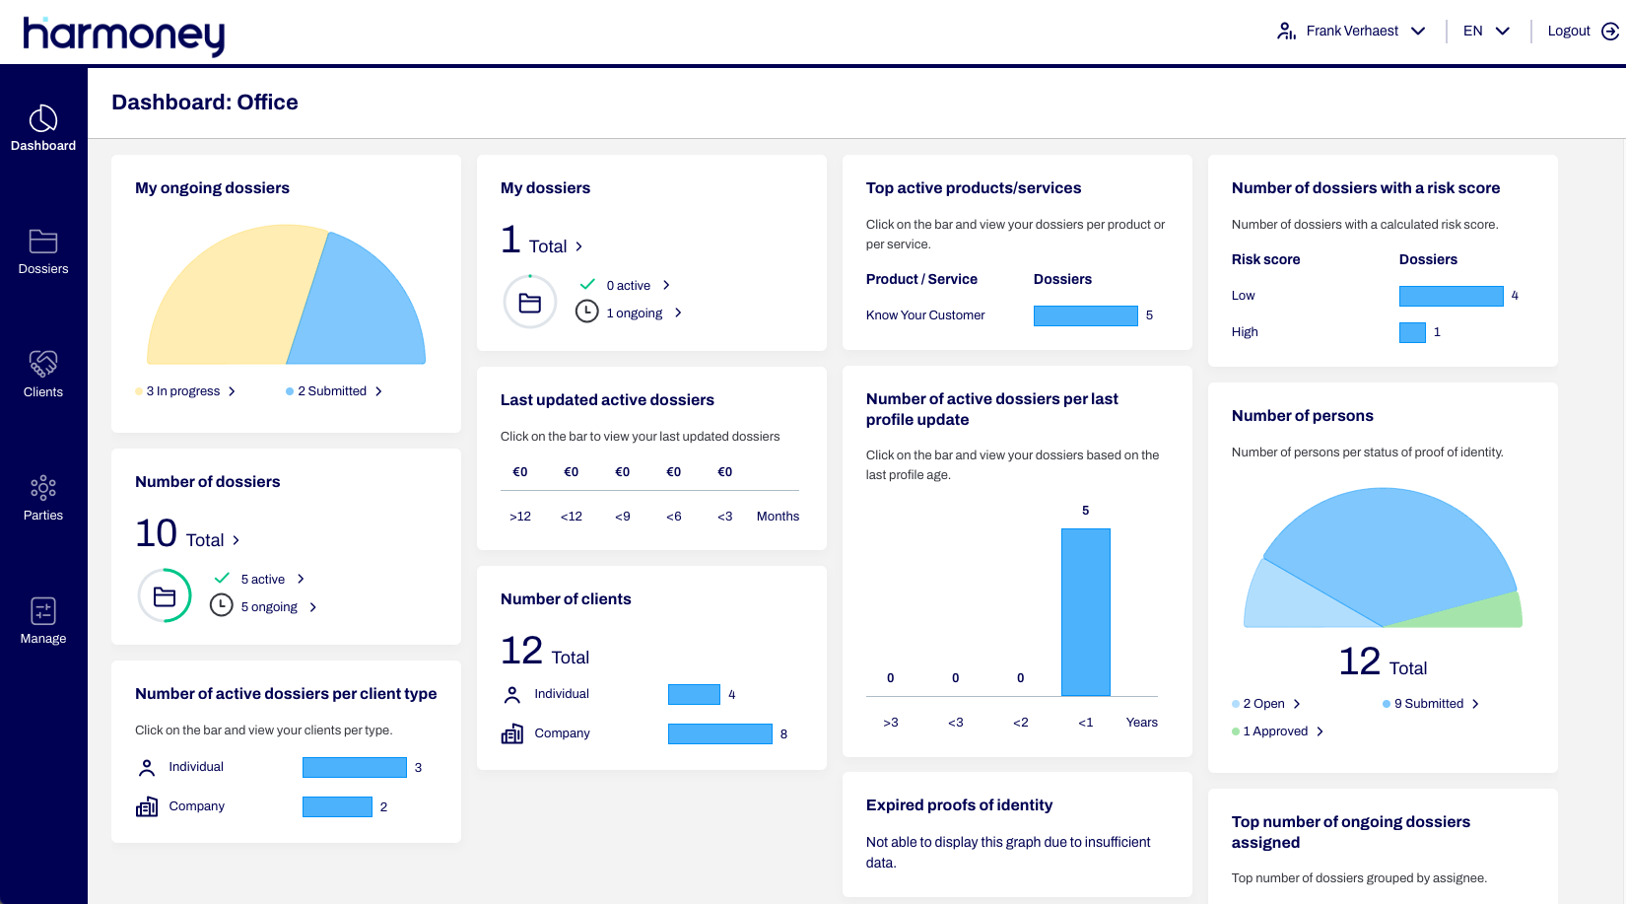
Notes:
You stay in control with workflows built around your policies, your tools, and your risk appetite.
Your team spends less time copying data between systems.
You view the whole process with customisable dashboards.
And your auditors? Well, they sleep better too.

Slide 11




average reduction of manual work
speed of customer onboarding
average time to reboard a complex client
more screenings per person
Notes:
It works.
Our clients report 90% less manual work.
5x faster customer onboarding
2x more screening per person
And only 8 min on average to reboard a complex client

Slide 12

Instant compliance with complete peace of mind
Notes:
Our customers adapt to new regulations without rebuilding everything from scratch.
They stop copying and pasting data.
They stop chasing signatures or missing screening deadlines.
They stop losing sleep before audits.
And their customers? They get a compliance experience that actually makes sense.

Slide 13




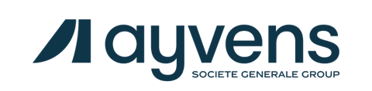
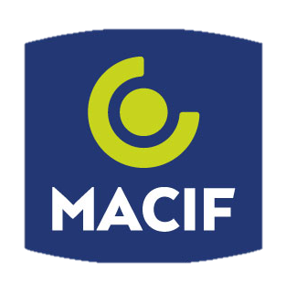
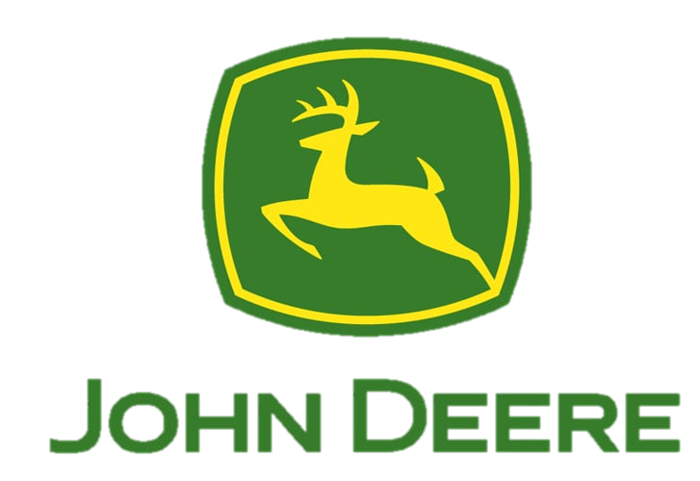



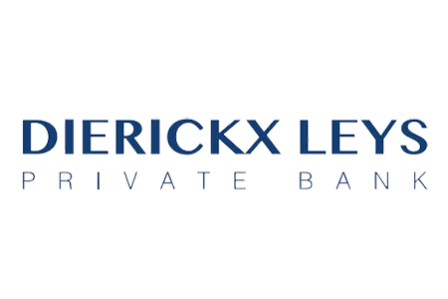


Trusted by banks, insurers, asset leasing, and more
Notes:
Our platform is already used by banks, insurers, asset and fund managers, and their consulting partners across Europe.
We’re growing fast, and currently expanding into the UK.

Slide 14



Harmoney in a nutshell
A multidisciplinary RegTech team of +50 banking & technology experts
Regulatory & compliance
KYC, KYB, AML, CRS …
Solutions & technology
Time & cost efficiency
User experiences
Customisable & scalable
Banking
Insurance
Leasing
Trusted by 60+ financial institutions
Headquarters in Belgium
Office in France (Paris)
Active in 7 countries

Slide 15
Let’s get in touch!
www.myharmoney.eu
jve@myharmoney.eu
Notes:
Want to see how it works? Then talk to us.

